Slide 1
Particiate in THE FUTURE WITH KA-RLO
The first AI Bokkeeping assistant in Croatia
Investment opportunity
INF. GERGELJ LAURA
095/726-6641

Slide 2
To build KA-RLO we need
€500K
€15K
€30
<1%
Initial Investment
Cooperation with IT company MONO d.o.o
Monthly Costs
Servers, maintenance, marketing
Client Price
Per month subscription
Market Share
Required for profitability
6. mos
1.
2.
3.
4.
5.
6.

Slide 3
KA-RLO IN NUMBERS 1% OF THE MARKET
250.000 * 1% = 2.500 * 30,00
75.000,00 eur / per month
KA-RLO IN NUMBERS 5% OF THE MARKET
250.000 *5% = 12.500 * 30,00
375.000,00 eur / per month

Slide 4
NOW 1% share = 11.000,00 eur
After 1 year the sky is the limit but let’s say 5% market, and revenue of 375.000 eur the share holder of 1% will earn
3.750,00 eur / mont
And that is only in Croatia – our gool is EU
INF. GERGELJ LAURA
095/726-6641

Slide 5
Payment data
Iban: HR03 2360 0001 1031 8092 8
SWIFT: ZABAHR2X Zagrebačka Banka
Description: capital reserves - your name and ID number
INF. GERGELJ LAURA
095/726-6641

Slide 6
Time line for launching AI KA-RLO
01.03.2025
05.04.2025
01.05.2025
01.08.2025
01.11.2025
Starting the investment oppotrunity
Signing the investment contract.
Sratting to build
KA-RLO.
Starting to teach
KA-RLO
Starting to test
KA-RLO
01.01.2026
01.06.2026
Launching
KA-RLO
Enter the stock market

Slide 7
Invest for AI KA-RLO d.o.o.
KA-RLO

Slide 8
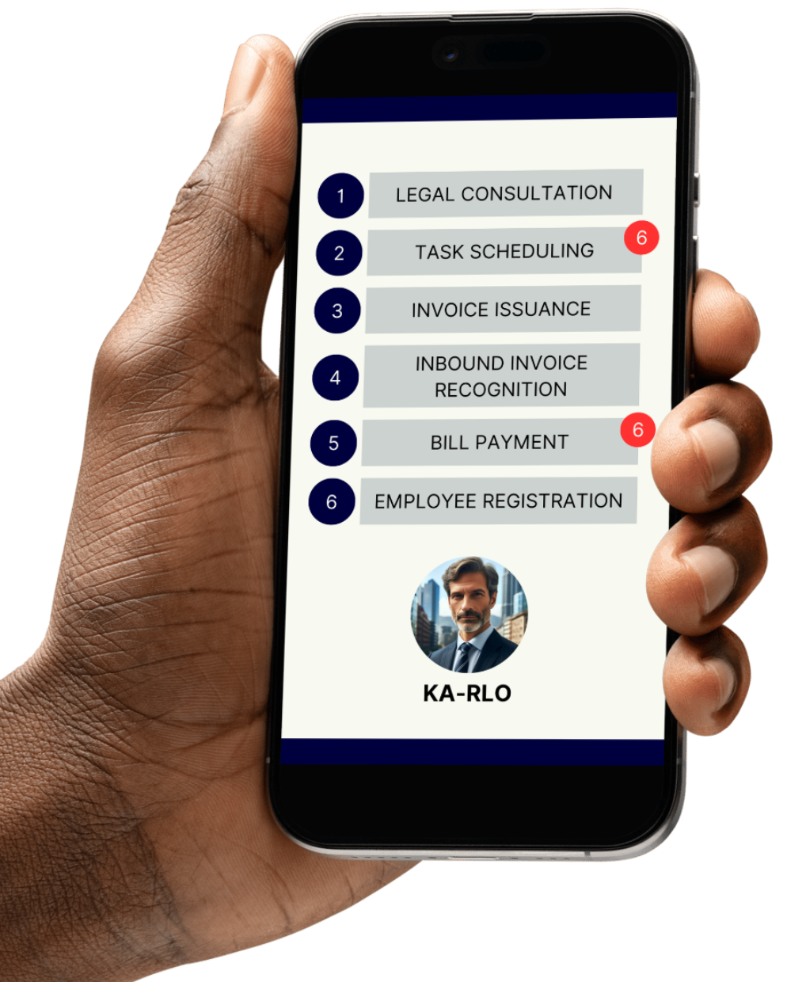
WHAT OR WHO IS KA-RLO
1
Chatbot – Responding to clients' diverse questions about VAT and law.
2
Scheduling – List with tasks/obligations for the client or bookkeeper (To-Do). Using FINA, e-porezna, CWIS
3
Issuing Invoices – Using different existing systems such as mojeRačun / Minimax
4
Incoming Invoices – Scanning with recognition and automatic posting/sending to the system for bookkeeping.
5
Bill Payment – Using the merBanking „e-Plati” system.
6
Employee Registration and Deregistration – Using the HZMO LANA system.

Slide 9
WHO NEEDS KA-RLO
Artisans /SME
Fully replaces the accountant for all artisans (100%).
Accountants
Performs 80% of tasks independently for micro-entrepreneurs.
Large companies
Replaces administrative staff.
250.000,00 active companes just in Croatia

Slide 10
WHO IS LAURA GERGELJ
1996
2000
2016
2017
2018
FOI Varaždin, Graduate IT Engineer
Founder DOM Računala d.o.o.
Senior Consultant FINA d.d.
Developer Manager
Ericsson Nikola Tesla
Servisi d.o.o.
Founder / Director
D-invoice d.o.o.
Franchise bookkeeping company
INNOVATIONS
EDUCATION
MMD – Mobile Multifunctional Display
MED & Milk – Cost-effective system for fresh food delivery
ONION – Products made from Red Onions
D-INVOICE – Franchise-based Accounting System
Independent Accountant
Project Cycle Management Leader
Expert in Financial Reporting
Expert in Anti-Money Laundering and Countering Financial Terrorism

